Slide 1

Homework 1
Analysis
By: Darren Pak

Slide 2
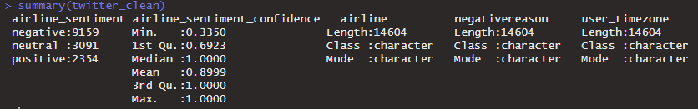
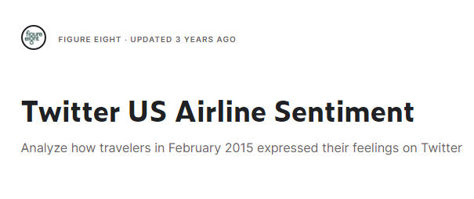

Dataset Overview
The Twitter Airline Sentiment dataset available on Kaggle contains 14,641 tweets(rows) about six major US airlines, including American, Delta, Southwest, United, US Airways, and Virgin America. The goal of the dataset is to classify the sentiment of each tweet as positive, negative, or neutral. The columns I chose to use for my dataset are "airline_sentiment", "airline_sentiment_confidence", "airline", "negativereason", “tweet_created”, and "user_timezone".

Slide 3

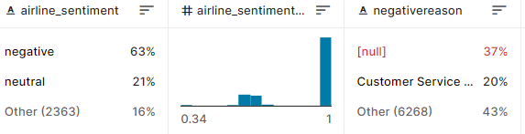
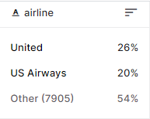
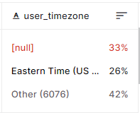
Data Quality and Analysis Tools
Overall, the data quality was mostly intact. The important columns like “airline_sentiment” had no missing values, however there still was clean up to be done. This was mainly in the “negativereason” and “user_timezone” column that were patched up with filler values to avoid errors.
For my tools I chose to go with Rstudio as my tool of choice for the analysis because it offers great plotting and personal ease of use.

Slide 4
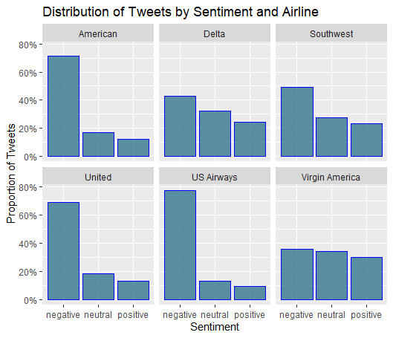
Sentiment Distribution
The first two questions are targeted towards better understanding the data and to dig for statistics that were of interest.
This graph shows the distribution of sentiment in percentages for each airline. We can see that for every single airline, negative sentiment is the majority. When a person tweets about an airline, this is usually to complain or highlight a negative experience rather than a positive one, which can explained by this observation.
Another noticeable trend is that American, United, and US Airways have a significantly higher proportion of negative tweets when compared to the Delta, Southwest, and Virgin America who have a more even distribution.

Slide 5
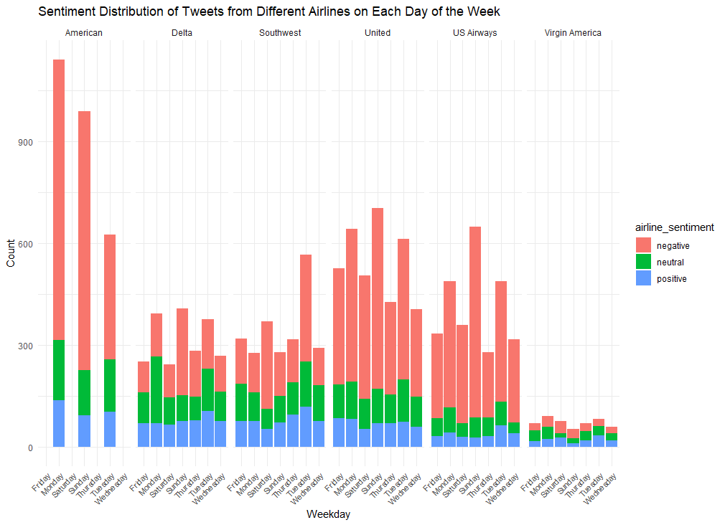
Distribution of Tweets by Day of the Week
By separating the tweets into the days of the weeks, this graph tells us a few key important points. First, the most interesting point is that American only had tweets from Mon, Sun, and Tues. But, spreading out those tweets puts them about average for total number of tweets. The last point is that Virgin America had by far the least amount of tweets. This may explain the even distribution of sentiment in the last graph.

Slide 6
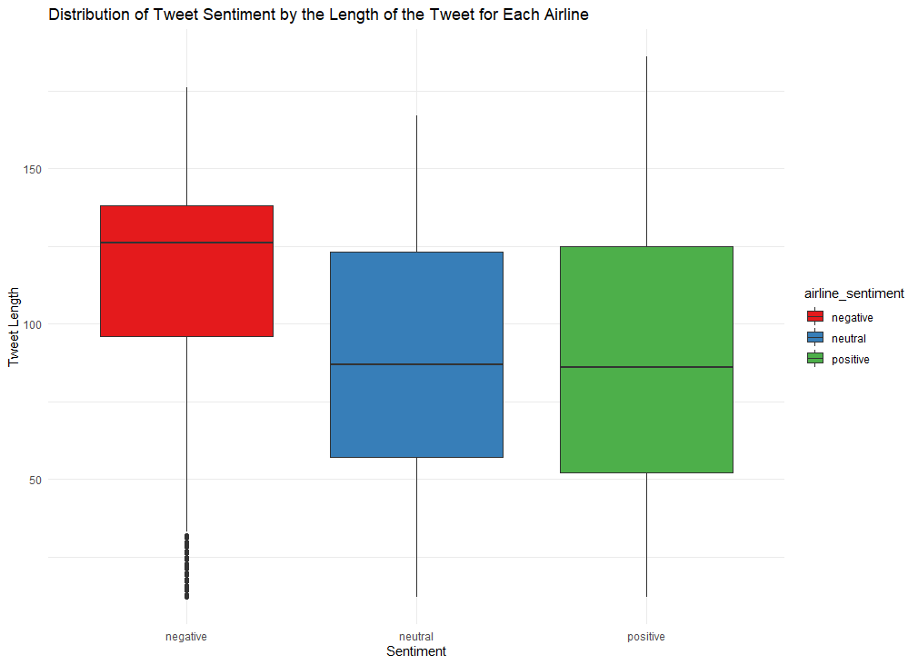
Length of Tweet by Sentiment
An interesting factor that could have played into the role of many tweets getting categorized as “negative” by the AI is the length of the tweet.
This box and whisker plot shows us that the average length of a negative tweet is about 25% larger than the neutral and positive tweets. From the way the AI categorizes tweets, this may be showing the bias towards categorizing longer tweets as negative.

Slide 7
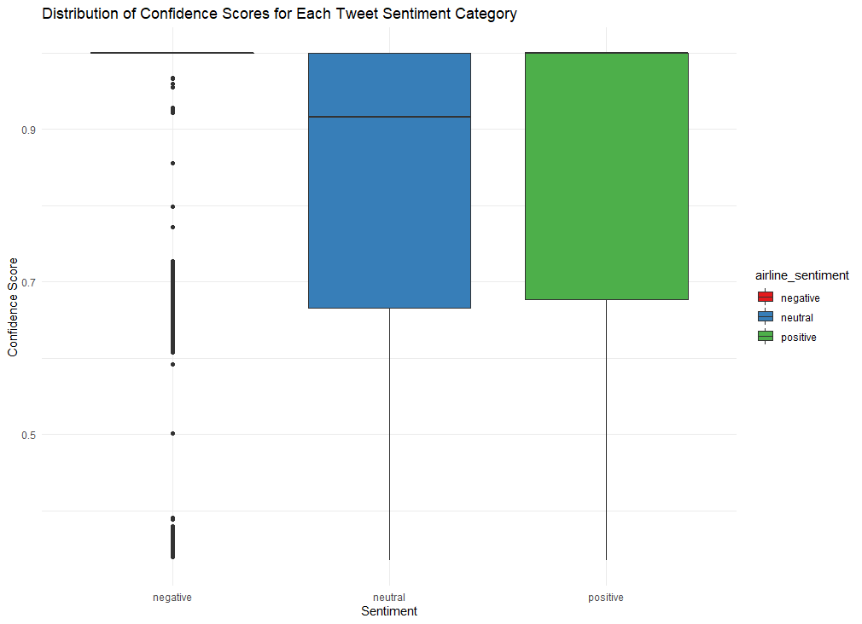
Distribution of Confidence Score of Sentiment
To confirm our suspicions, I looked into the distribution of confidence scores for each sentiment. Negative shows an almost perfect 1 average meaning that the AI is fully confident that it had recognized the negative tweets correctly. Pairing this with our last question, we can conclude that longer tweets are more likely to be negative with the AI worse at predicting neutral and positive tweets.

Slide 8
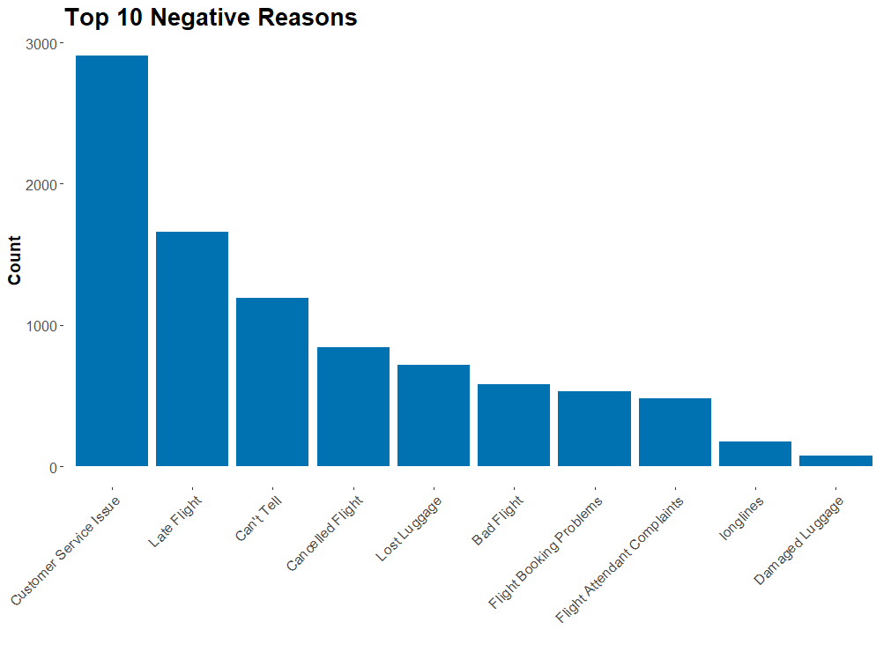
Why are airlines getting negative feedback?
Next, I looked into the reasons why airlines might be getting negative reviews.
From the “negativereason” column, I created a bar chart to plot the frequencies of each reason. The top issue with the airlines was Customer Service. This shows how airlines may be able to improve their relationship with customers through investing into ensuring on-time flights and resolving customer service issues in a timely manner.

Slide 9
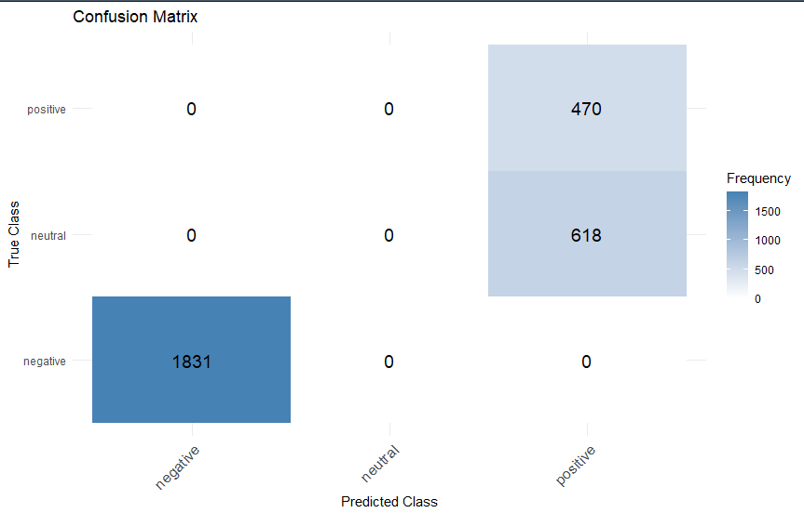
Trying to Predict Airline Sentiment
Using a logistic regression model, I was using Airline, Reason, and Timezone to predict Airline Sentiment. I used an 80/20 training test split and overall the model performed well.
With only a small portion of false positives in from neutral, the model was able to perfectly predict all of the negative reviews. This shows us that the logistic regression model is proficient in being able to predict Airline Sentiment given Reason and Timezone of the user.
However, a fatal flaw to this model is it might have result from bias because Reason and Airline Sentiment are too closely related. In future iterations, this may have different predictors.

Slide 10
Executive Summary
To start off with, let’s talk about the interesting points from the data. Through the analysis, I found that for the AI likes to categorize longer tweets as negative and also has a much higher confidence for this over the positive and neutral ones. Some specifics for the airlines is that Delta only had tweets from certain days, and Virgin Airlines had the lowest tweet count. Also, if you ever need to choose an airline to fly with, we find that Delta, Southwest, and Virgin America are your best choices into avoiding bad experiences.
The main takeaway from the analysis is that Twitter users are more likely to leave negative Tweets over positive/neutral ones. From this, we see that the purpose of creating this dataset was going to be most useful to the airline’s in the dataset. By taking a deeper dive into the data, important information on what areas should be improved in their service can be extracted as seen in the Top 10 chart. Airlines have been notorious for a lack of customer service, and the analysis proves that customers are finding some point to be unacceptable, thus posting it on the internet. From the logistic regression model, we are able to find that Airline Sentiment is very predictable through models using the other data available like Timezone and Reason. Although the model was not perfect, I was able to showcase its use through an attractive confusion matrix.
Notes:
Highlights key learnings and takeaways from analysis

Slide 11
Appendix
All of the material can be found on Github: https://github.com/dapak2002/MGSC-410-Homework-1

